Slide 1
19PHY101
Engineering Physics A
Unit V :
Solid State Physics

Slide 2
Objectives
Drude Model - Classical thoery - electron conductivity in
metal
Classification : Metal -Semiconductor - Insulator (Qualitatively)

Slide 3

Drude model of electrical conduction
The electric current density J is defined as the net amount of charge flowing across a unit area per unit time, that is,
- Δq is the net quantity of charge flowing through an area A in time Δt

Slide 4
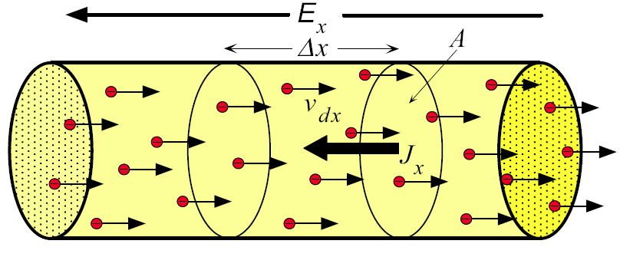
Drude model of electrical conduction
Figure shows the net flow of electrons in a conductor section of cross-sectional area A in the presence of an applied field E_{x}.
Notice that the direction of electron motion is opposite to that of the electric field E_{x} and of conventional current, because the electrons experience a Coulombic force eE_{x} in the x direction, due to their negative charge.

Slide 5
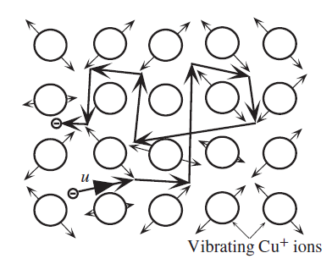
Drude model of electrical conduction
Motion of a conduction electron in a metal
A conduction electron in the electron gas moves about randomly in a metal (with a mean speed u) being frequently and randomly scattered by thermal vibrations of the atoms.
In the absence of an applied field there is no net drift in any direction

Slide 6
Drude model of electrical conduction
Motion of a conduction electron in a metal
In the presence of an applied field, E_{x} , there is a net drift along the x direction. This net drift along the force of the field is superimposed on the random motion of the electron.
After many scattering events the electron has been displaced by a net distance, Δx, from its initial position toward the positive terminal.

Slide 7
Drift Velocity
Drude model of electrical conduction
Drift velocity is the average velocity in x-direction
v_{dx} = drift velocity in x direction, N = number of conduction electrons, v_{xi} = x direction velocity of ith electron

Slide 8

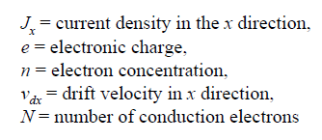
Drude model of electrical conduction
Current Density
The current density in the x direction is
Suppose that n is the number of electrons per unit volume in the conductor (n = N ∕ V). In time Δt, electrons move a distance
Δx = v_{dx} Δt, so the total charge Δq crossing the area A is enA Δx.

Slide 9
Drude model of electrical conduction
Current Density and Drift Velocity
J_{x} (t) = env_{dx}(t)
J_{x} = current density in the x direction, e = electronic charge, n = electron concentration, v_{dx} = drift velocity

Slide 10
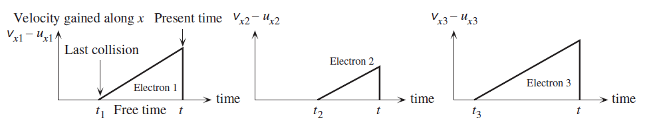
Drude model of electrical conduction
To calculate the drift velocity v_{dx} of the electrons due to applied field E_{x}, we first consider the velocity v_{xi} of the i_{th} electron in the x direction at time t.
If its last collision was at time t_{i}; therefore, for time (t − t_{i}), it accelerated free of collisions
Velocity gained in the x direction at time t from the electric field (E_{x}) for three electrons. There will be N electrons to consider in the metal.

Slide 11

Drude model of electrical conduction
For i^{th} electron in a metal :
u_{xi} be the initial velocity of i^{th} electron
eE_{x} ∕ m_{e} is the acceleration of the electron
time (t − t_{i}) --- accelerated free of collisions
the velocity v_{xi} in the x direction at time t will be
initial velocity
gained velocity due to E_{x}
= acceleration (dV/dt) x time (dt)

Slide 12


Drude model of electrical conduction
For N electrons in the metal :
The drift velocity,
If τ is mean time between the collisons, then

Slide 13


Drude model of electrical conduction
The drift velocity can be written as
drift mobility
J_{x} (t) = env_{dx}(t) = enμ_{d} E_{x}
Ohm's Law : J = σ E
Conductivity : σ = neμ

Slide 14
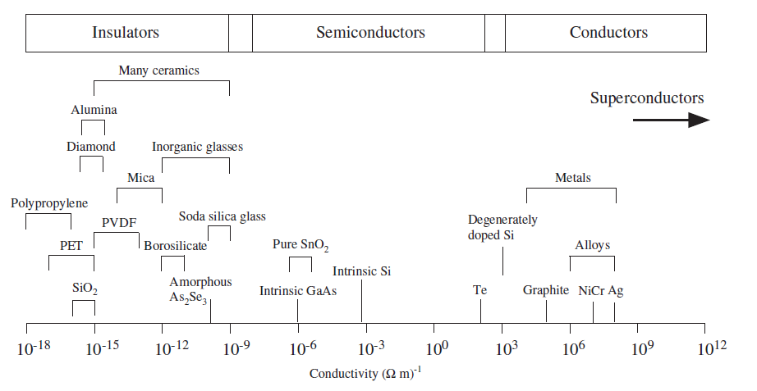
Metal - Semiconductor - Insulators

Slide 15
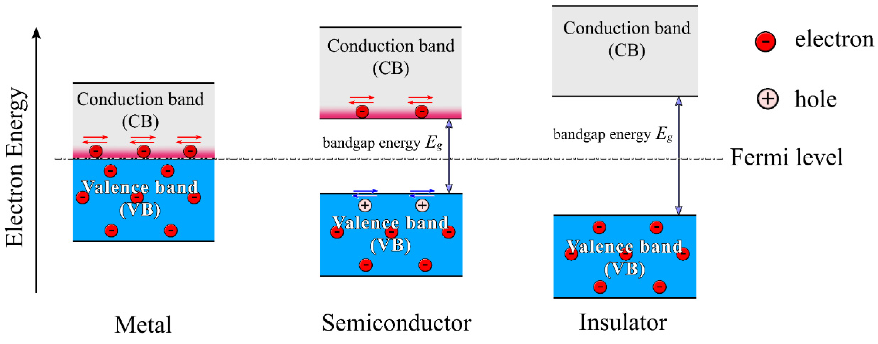
Metal - Semiconductor - Insulators
E_{g} = 0
E_{g} = 0.1 to 4 eV
E_{g} > 4 eV

